Slide 1


MAR
2022
Lin Re-skill BOOTCAMP

Slide 2
Schedule
DAY 1
    Intro to Linux
    Filesystem Hierarchy Standard (FHS)
    Absolute vs. Relative PATH
    Navigating shortucts & commands
    First Linux Commands
    help & man
    Creation of directories
    Creation of files
    Intro to VIM Editor
    Copy and move of files and directories
    Removal of files and directories
    Viewing the content of the file
    Shortcuts in Linux
    Get in touch with VirtualBox
    Linux installation via VBox
1

Slide 3
Čo je LINUX ???
Linux je operačný systém
Linux je moderný OS
Linux je stabilný OS
Linux je imúnny voči počítačovým vírusom
Linux je k dispozícii v rôznych formách – linuxových distribúciách
Linux je FREE (GPL License)
2

Slide 4
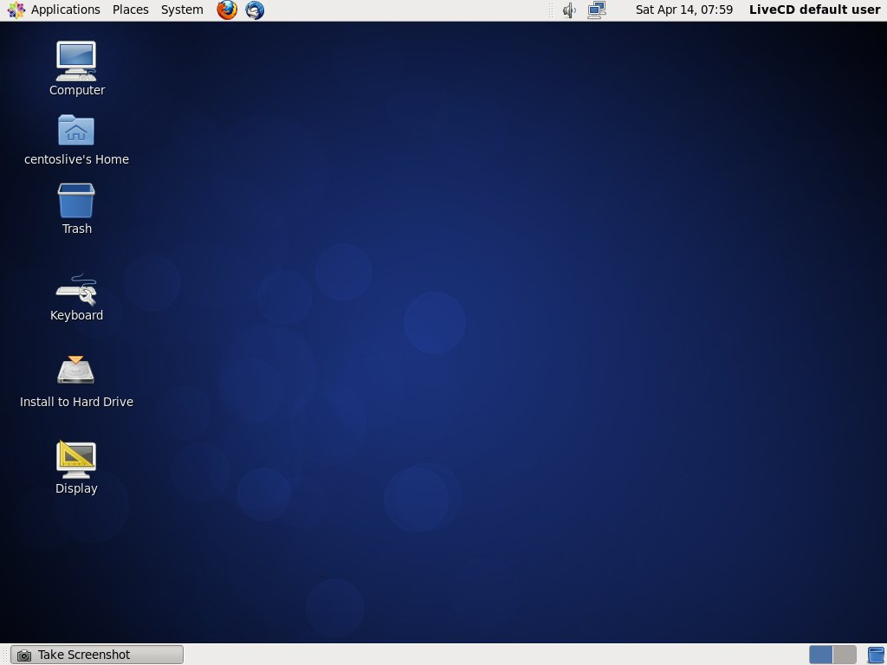

Ako vyzerá LINUX ???
vs
GUI
Terminal
3

Slide 5
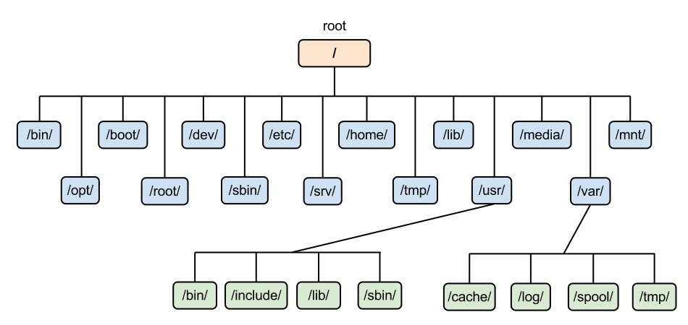
Starting with LINUX ...
Linux = kolekcia súborov a adresárov
Top adresár sa nazýva
4

Slide 6
Linux Filesytem Hierarchy (FHS)
/ – domovský adresár superužívateľa (root)
/boot – statické súbory pre štart systému (bootloader)
/bin – základné binárky (for all)
/sbin – systémové binárky
/etc – systémové konfiguračné súbory
/home – domovské adresáre užívateľov
/opt – freeware, programy tretích strán
/var – logy
/usr – inštalovaný software
/tmp – dočasné súbory (kôš)
/media – USB, removable media
/mnt – mountpoint pre dočasne pripojený filesystém
5

Slide 7
Absolute vs. Relative PATH
Absolútna cesta – je určenie polohy súboru na disku bez ohľadu
na aktuálny adresár
/home/joe/foto/xx.jpeg
Relatívna cesta – je určenie polohy súboru na disku
vzhľadom na aktuálny adresár
pwd
/home/joe/
cd foto
Absolute: Relative:
/home/joe/foto foto
6

Slide 8
Navigating shortcuts & commands
/ – root directory
. – the current directory
.. – the parent directory
~ – the home directory of user
pwd – show working directory
cd – change directory
7

Slide 9
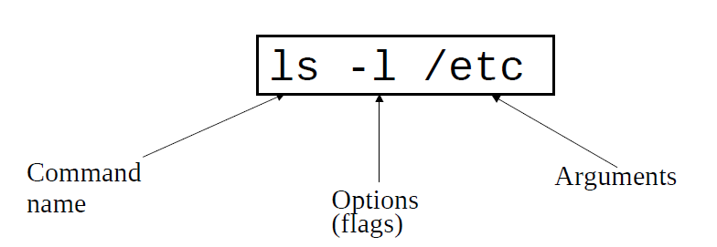
Linux command basics
To execute a command, type its name and arguments at the
command line:
9

Slide 10
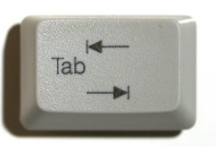
Your best Linux friend
Get familiar with Tab for auto completion of Linux commands
9

Slide 11
First commands
ls – list content of the current directory
mkdir/rmdir – create or remove directories
touch – change file timestampts
mv – move or rename files and folders
cp – move or rename files and folders
rm – remove files or directories
cat – print content of the file on the screen
head – displays first 10 lines of a file
tail – display last 10 lines of a file
who – show who is logged on
whoami – print effective userid
clear – clear the screen
history – last executed commands
exit – quit the terminal (logout)
10

Slide 12
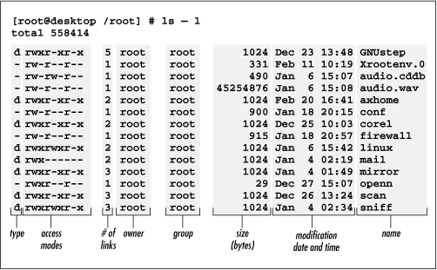
“ls –l” command explained
11

Slide 13
mkdir and rmdir
mkdir - make directories
rmdir - remove empty directories
Examples:
mkdir folder{a,b,c}
mkdir folder{1..10}
rmdir foldera -> removes foldera
rmdir fol* -> removes all folders starting with “fol”
12

Slide 14
Move/Rename and Copy
mv [OPTION]... SOURCE... DIRECTORY
cp [OPTION]... SOURCE... DIRECTORY
Examples:
mv file1.txt /tmp -> moves file1.txt into /tmp folder
cp file1.txt /tmp -> copies file1.txt into /tmp folder
mv file1.txt file2.txt -> renames file1.txt to file2.txt
12

Slide 15
Links between files (shortcuts)
ln [OPTION]... [-T] TARGET LINK_NAME
Example:
ln –s myfile ~/Desktop/shortcut-myfile
13

Slide 16

Where to Get Help ???
You can always read the manual!
To see the “man page” for the ls command:
man ls
List of available parameters for a particular command:
ls -help
RTFM!
14

Slide 17
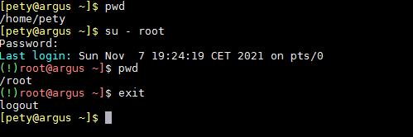
Changing user’s identity
su - username
su
15

Slide 18
VIM Survival Kit
i -> Enter “Insert” Mode
ESC -> Exit “Instert” Mode
ZZ -> save & quit
:q! -> quit without saving
:wq! -> save and quit
16

Slide 19
VIM Extended
dd -> Removes a line
yy -> copies a line
p -> paste
:u -> undo
:x -> removes a single character
16

Slide 20
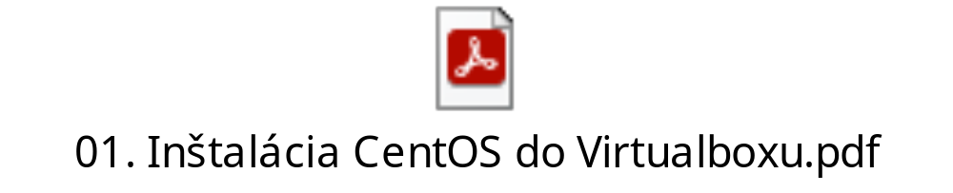
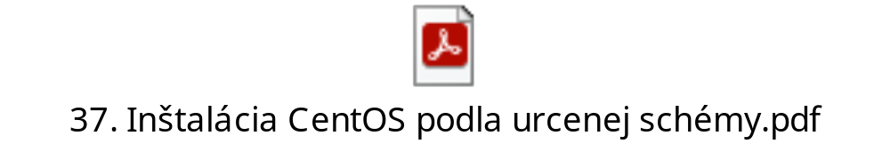
Linux Installation
Download .iso
Spin up new VM using VirtualBox
15

Slide 21


Slide 22
Schedule
DAY 2
    Intro to SHELL Scripts
    Aliases
    Linux File Permissions
    GREP
    Users Management
  Creation of Users
  Deletion of Users
  Modification of Users
  Setting Expiration of User accounts
17

Slide 23
Aliases
How to create alias?
> edit .bashrc for particular user
> construct alias
alias c='clear‘
reload bash
Examples:
18

Slide 24
Group Management
groupadd
groupdel
Examples:
groupadd -g 666 admins
groupdel admins
18

Slide 25
User Management I.
useradd
-u -> set UUID
-c -> set comment
-g -> set primary group membership
-G -> set secondary group membership
-d -> set home directory
-m -> makes home directory if not exists yet
-E -> set Account expiration
-p -> set Password for user (Must be Encrypted!)
echo “Passw0rd" | openssl passwd -1 -stdin
userdel
-r -> removes also files owned by user (home dir)
18

Slide 26
User Management II.
Examples:
useradd -u 1111 -c “Test User” -g 666 -s /bin/bash -d /home/tester -m tester
userdel -r tester
passwd tester -> set password for user tester (as root)
18

Slide 27
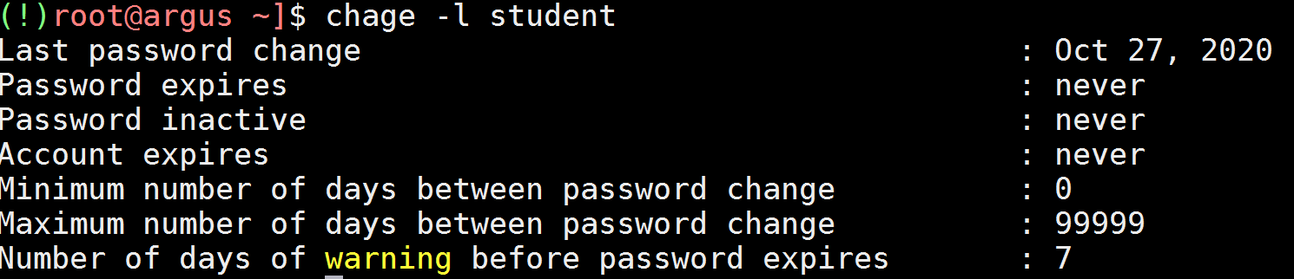
User Management III.
Account/Password Expiration can be set via chage command
18

Slide 28
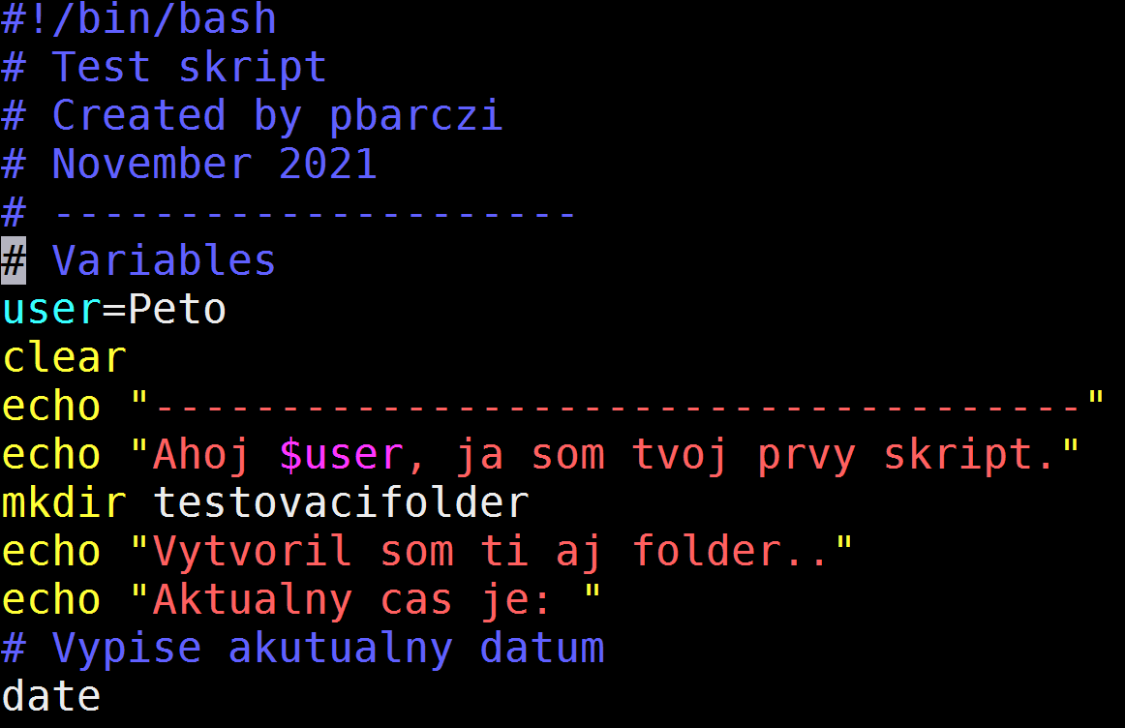
Shell script
18

Slide 29
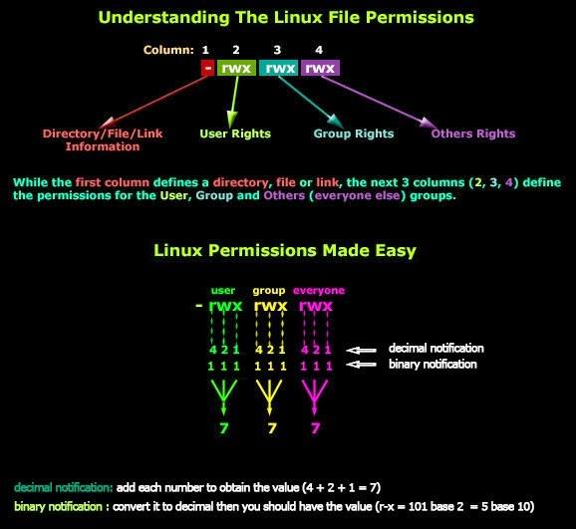
Linux File Permissions I.
18

Slide 30
Linux File Permissions II.
chmod
chown
chgrp
Examples:
18

